Slide 1
Systems Analysis and Design 11th Edition
Toolkit C – The Systems Analyst’s Toolkit Financial Analysis Tools

Slide 2
Chapter Objectives
Define economic feasibility
Classify costs and benefits into various categories, including tangible or intangible, direct or indirect, fixed or variable, and developmental or operational
Understand chargeback methods and how they are used

Slide 3
Chapter Objectives (Cont.)
Use payback analysis to calculate the length of time that it takes for a project to pay for itself
Use return on investment analysis to measure a project’s profitability
Use present value analysis to determine the value of a future project measured in current dollars

Slide 4
Describing Costs and Benefits
Systems analyst is required to review a project’s costs and benefits at the end of each SDLC phase
Helps management decide on continuing or terminating the project
Identifying and classifying all costs and benefits is important
Determining economic feasibility requires considering the project’s benefits compared to the total cost of ownership (TCO)

Slide 5
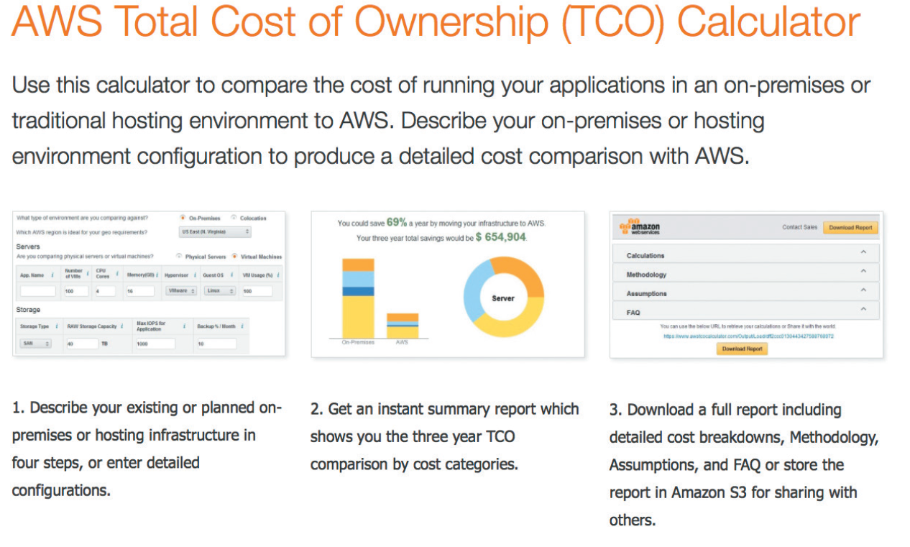
Describing Costs and Benefits (Cont. 1)
FIGURE C-1 Amazon.com offers a calculator to compare the TCO of running applications on-premises or in the cloud using AWS.
Source: Amazon Web Services, Inc.

Slide 6
Describing Costs and Benefits (Cont. 2)
Cost Classifications
Tangible costs - Costs to which a specific dollar value can be assigned
Example - Interest charges paid on borrowed money
Intangible costs - Costs whose dollar value cannot be calculated easily
Examples - Cost of customer dissatisfaction and lower employee morale
Direct costs: Costs that can be associated with the development of a specific system
Examples - Salaries of project team members and the purchase of hardware

Slide 7
Describing Costs and Benefits (Cont. 3)
Indirect costs (overhead expenses): Cannot be attributed to the development of a particular information system
Examples - Salaries of network administrators, copy machine rentals, and insurance expenses
Fixed costs: Costs that are constant and do not depend on a level of effort
Examples - Salaries and hardware rental charges
Variable costs: Vary depending on the level of activity
Examples - Costs of printer paper, supplies, and telephone charges

Slide 8
Describing Costs and Benefits (Cont. 4)
Developmental costs: Costs that are incurred once, at the time the system is developed or acquired
Examples - Salaries of people involved in systems development, and software purchases
Operational costs - Incurred after the system is implemented and continue while the system is in use
Examples - System maintenance and ongoing training

Slide 9
Describing Costs and Benefits (Cont. 5)
Managing Information Systems Costs and Charges
Direct costs are easier to identify and predict than indirect costs
Chargeback methods: Use accounting entries to allocate the indirect costs of running the IT department
No charge method
Fixed charge method
Variable charge method based on resource usage
Variable charge method based on volume

Slide 10
Describing Costs and Benefits (Cont. 6)
Benefit Classifications
Benefits can be classified as tangible or intangible, fixed or variable, and direct or indirect
Alternative benefit classification related to the nature of the benefits
Positive benefits increase revenues, improve services, or contribute to the organization as a direct result of the new information system
Cost-avoidance benefits: Expenses that would be necessary if the new system were not installed

Slide 11
Cost-Benefit Analysis
Process of comparing the anticipated costs of an information system to the anticipated benefits
Payback Analysis
Process of determining how long it takes for an information system to pay for itself
Payback period: Time taken to recover the system’s cost
Steps to perform payback analysis
Determine the initial development cost of the system

Slide 12
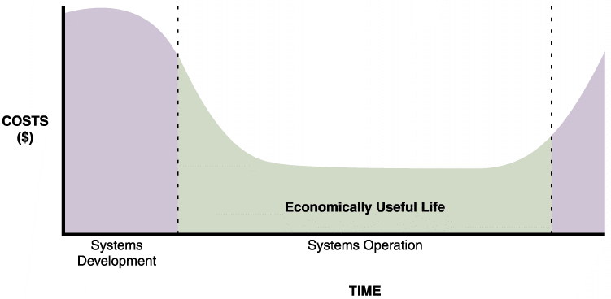
Cost-Benefit Analysis (Cont. 1)
Estimate annual benefits and determine annual operating costs
Compare total development and operating costs to the accumulated value of the benefits produced by the system to find the payback period
FIGURE C-2 The costs of a typical system vary over time. At the beginning, system costs are high due to initial development expenses. Costs then drop during systems operation. Maintenance
costs begin to increase until the system reaches the end of its economically useful life.

Slide 13
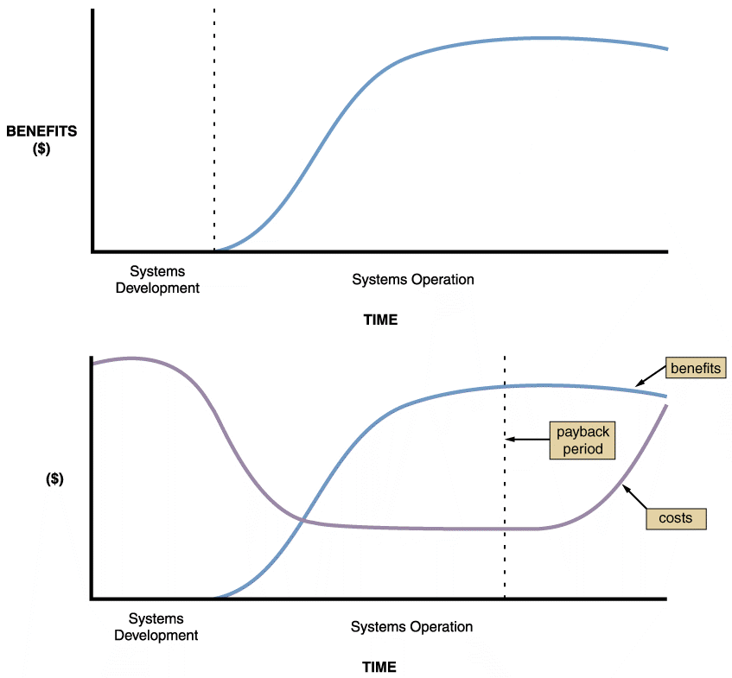
Cost-Benefit Analysis (Cont. 2)
FIGURE C-3 Benefits of an information system change over time, as shown in the upper graph. The lower graph shows costs and benefits plotted on the same graph. The dashed line indicates the payback period, when accumulated benefits equal accumulated costs.

Slide 14
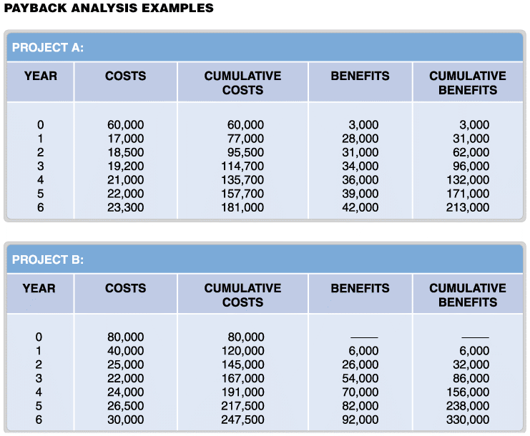
Cost-Benefit Analysis (Cont. 3)
FIGURE C-4 Payback analysis data for two information systems proposals: Project A and Project B.

Slide 15
Cost-Benefit Analysis (Cont. 4)
Using a Spreadsheet to Compute Payback Analysis
Step 1 - Design the worksheet and label the rows and columns
Step 2 - Entering the cost and benefit data for each year and the formulas
Payback analysis requires a formula to display cumulative totals, year by year
Step 3 - Verify that the spreadsheet operates properly
Step 4 - Create a line chart displaying the cumulative costs, benefits, and payback period

Slide 16
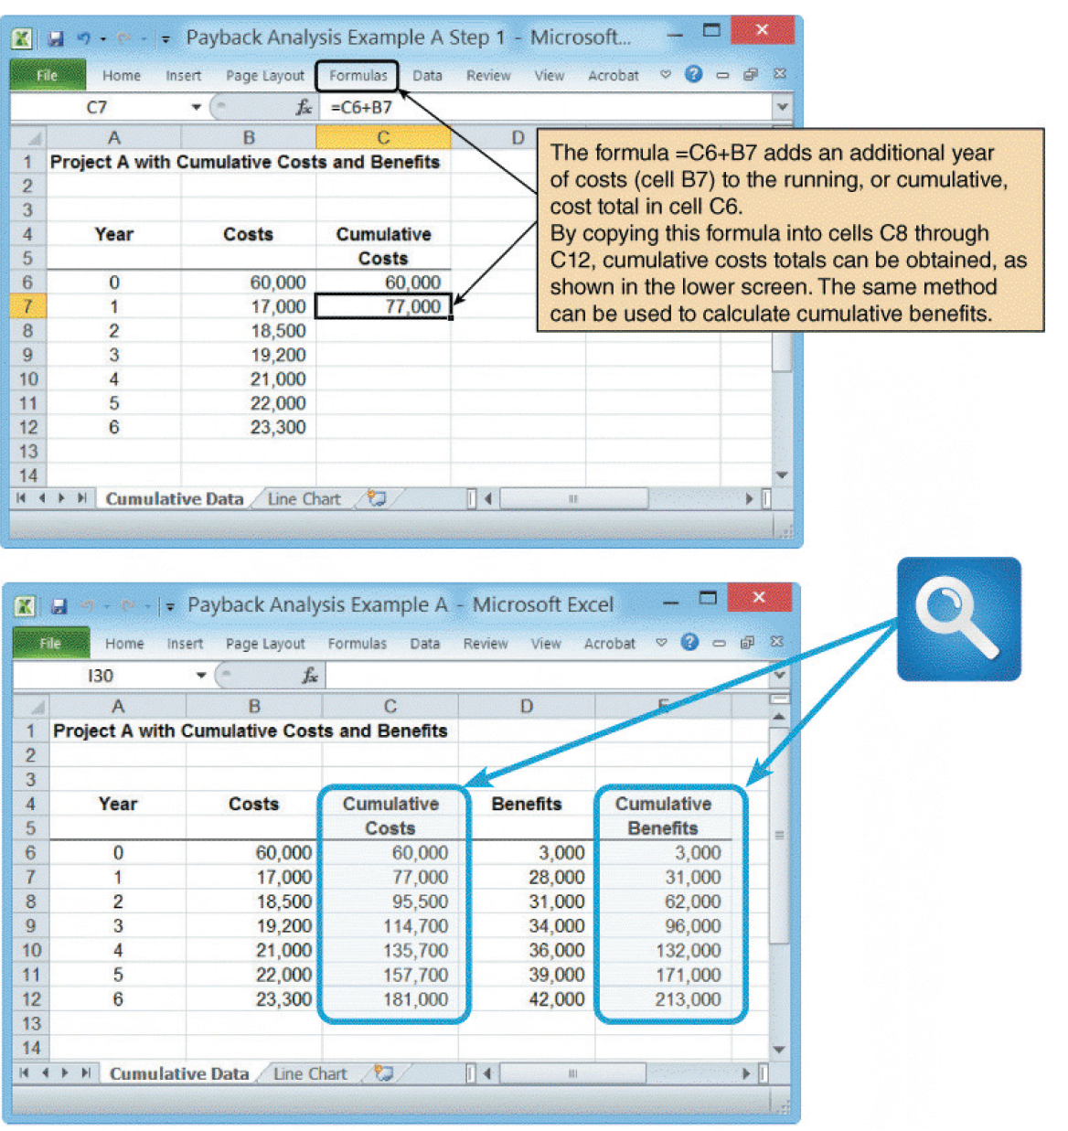
Cost-Benefit Analysis (Cont. 5)
FIGURE C-5 A Microsoft Excel worksheet displays payback analysis data for Project A in the upper screen. When cumulative cost and benefit formulas are entered, the finished worksheet in the lower screen appears.

Slide 17
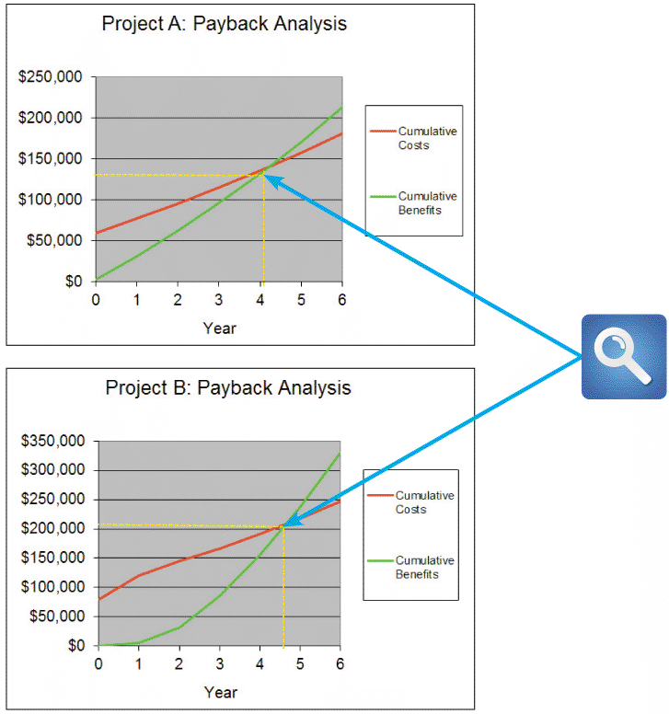
Cost-Benefit Analysis (Cont. 6)
FIGURE C-6 Microsoft Excel can be used to show the payback period by creating a chart of cumulative costs and benefits. Note that Project A has a shorter payback period than Project B.

Slide 18
Cost-Benefit Analysis (Cont. 7)
Return on Investment Analysis (ROI)
Percentage rate that measures profitability
Compares the total net benefits (the return) received from a project to the total costs (the investment) of the project
ROI = (total benefits – total costs) / total costs
Considers costs and benefits over a longer time span than payback analysis
Projects are usually expected to meet or exceed a minimum ROI

Slide 19
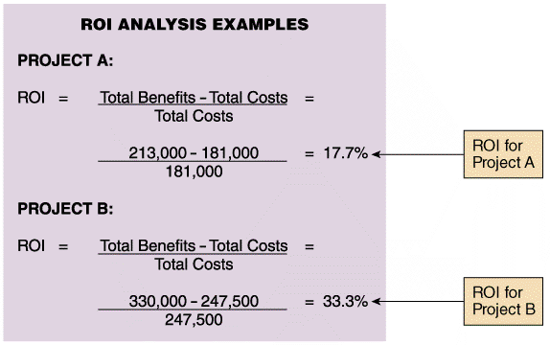
Cost-Benefit Analysis (Cont. 8)
FIGURE C-7 Return on investment analysis for Project A and Project B shown in Figure C-4.

Slide 20
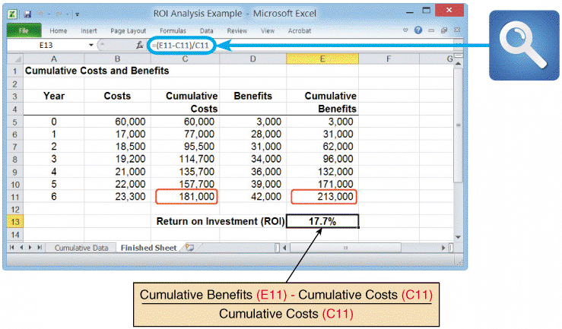
Cost-Benefit Analysis (Cont. 9)
Using a Spreadsheet to Compute ROI
FIGURE C-8 Sample ROI worksheet. Notice that cell E13 contains the ROI formula.

Slide 21
Cost-Benefit Analysis (Cont. 10)
Present Value Analysis
Based on the concept of time value of money
Present value of a future dollar
Amount of money that, when invested today at a certain interest rate, grows to exactly one dollar at a certain point in the future
Discount rate - Specified interest rate
Present value tables: Contain adjustment factors for various interest rates and numbers of years

Slide 22
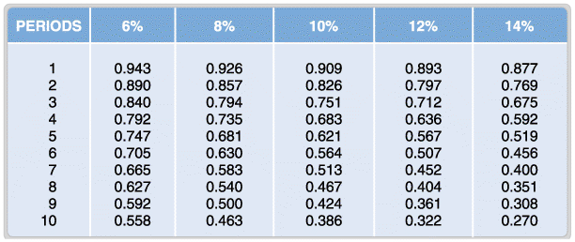
Cost-Benefit Analysis (Cont. 11)
FIGURE C-9 Portion of a present value table showing adjustment factors for various time periods and discount rates. Values in the table are calculated using the formula shown in the text. Notice how the factors decrease as time and percentage increase.

Slide 23
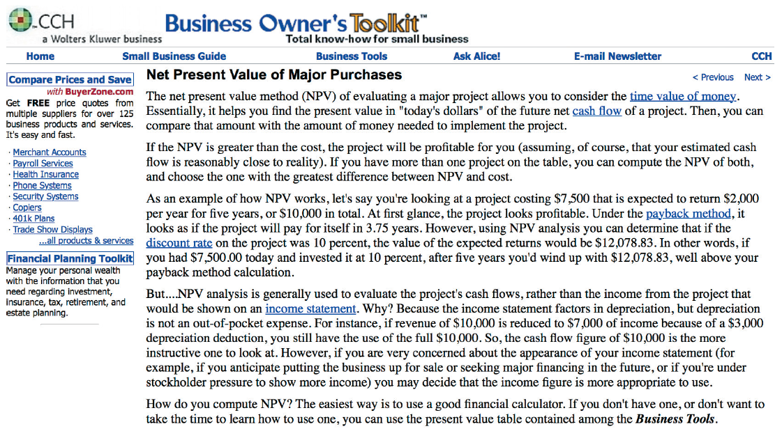
Cost-Benefit Analysis (Cont. 12)
FIGURE C-10 The CCH Business Owner’s Toolkit offers a small business guide, and a wide range of financial tools, including guidance on calculating net present value.
Source: CCH Incorporated

Slide 24
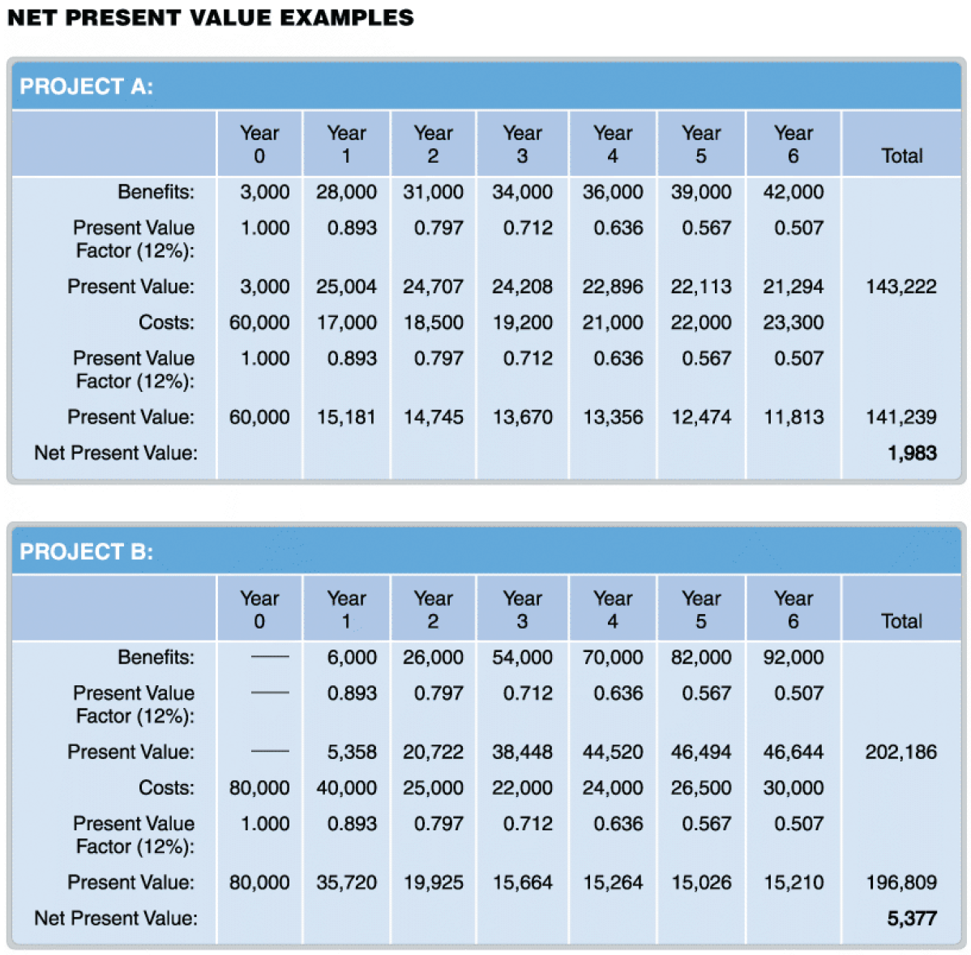
Cost-Benefit Analysis (Cont. 13)
FIGURE C-11 Net present value analysis for Project A and Project B. The tables use discount factors from external sources, such as the CCH site shown in Figure C-10.

Slide 25
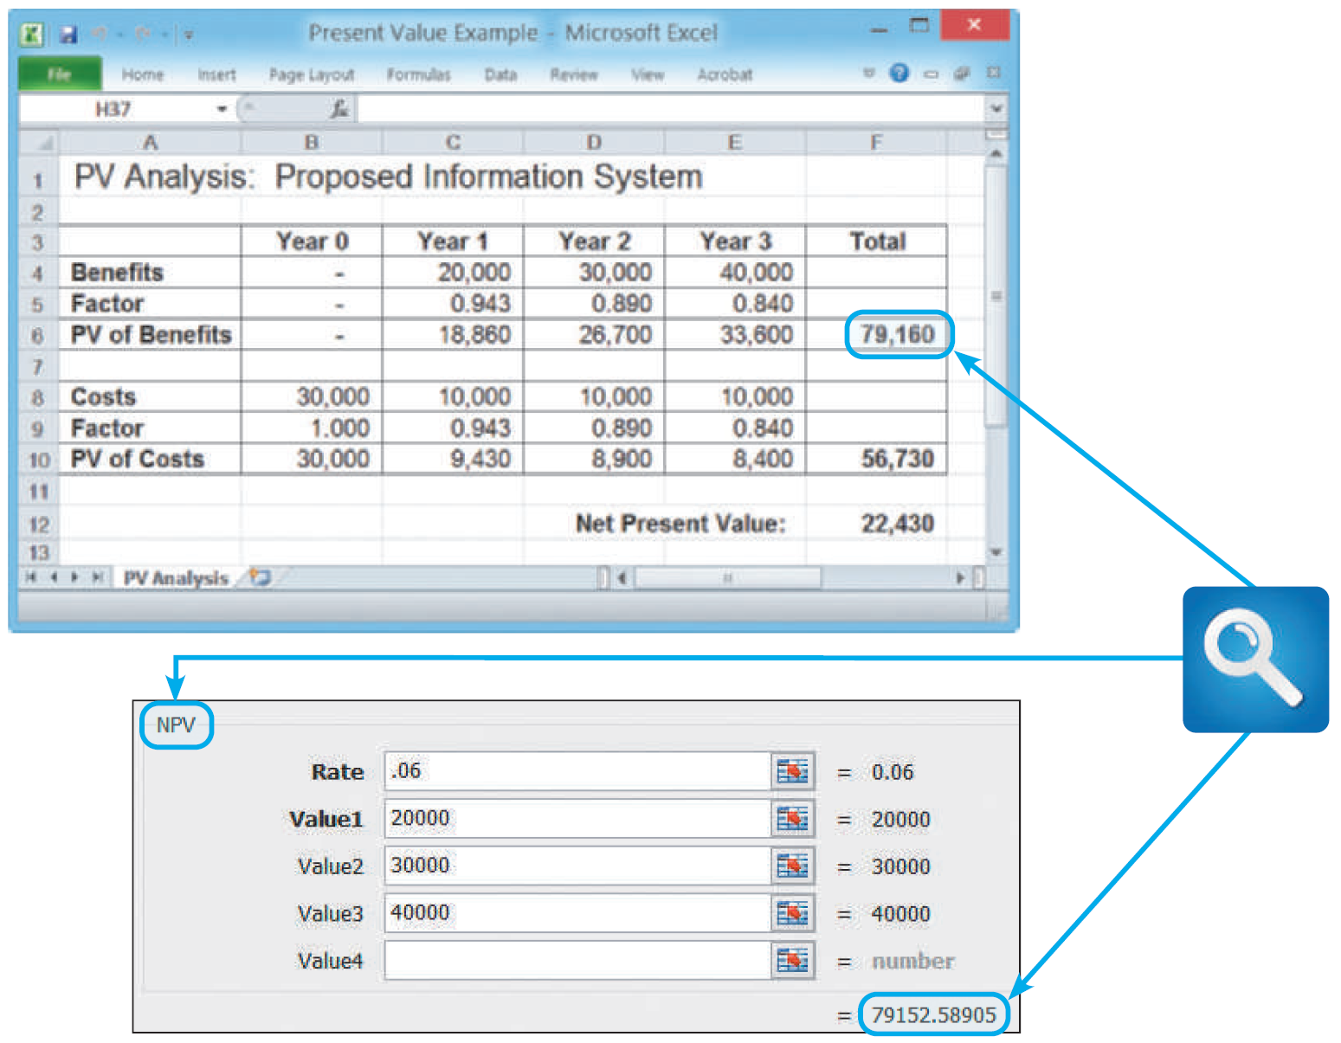
Cost-Benefit Analysis (Cont. 14)
Using a Spreadsheet to Calculate Present Value
FIGURE C-12 The top screen shows how to use discount factors to calculate present value in a Microsoft Excel spreadsheet. In this case, the present value of benefits is $79,160. The bottom screen shows an example of the NPV function, which is a menu-driven formula that is built into Excel. The slight difference between the values is because Excel uses more decimal places.

Slide 26
Toolkit Summary
A systems analyst must be concerned with economic feasibility throughout the SDLC
Classification of project costs
Tangible or intangible, direct or indirect, fixed or variable, and developmental or operational
Common chargeback approaches
No charge, a fixed charge, a variable charge based on resource usage, or a variable charge based on volume

Slide 27
Toolkit Summary (Cont.)
Classification of system benefits
Tangible or intangible, fixed or variable, direct or indirect, and positive or cost-avoidance
Approaches to cost-benefit analysis
Payback analysis determines the time it takes for a system to pay for itself, which is called the payback period
Return on investment analysis measures a system by comparing net benefits to total costs
Present value analysis adjusts the value of future costs and benefits to account for the time value of money

